Slide 1





How do resource abundance and stochasticity affect animal movement?
Stefano Mezzini – M.Sc. Biol.

Slide 2
Why do animals move?
Searching for food/nutrients
Searching for water
Searching for new den/nest
Searching for mate/group
Escaping predators/competitors
Defending resources/territory
Can measure HR instead of individual needs

Slide 3
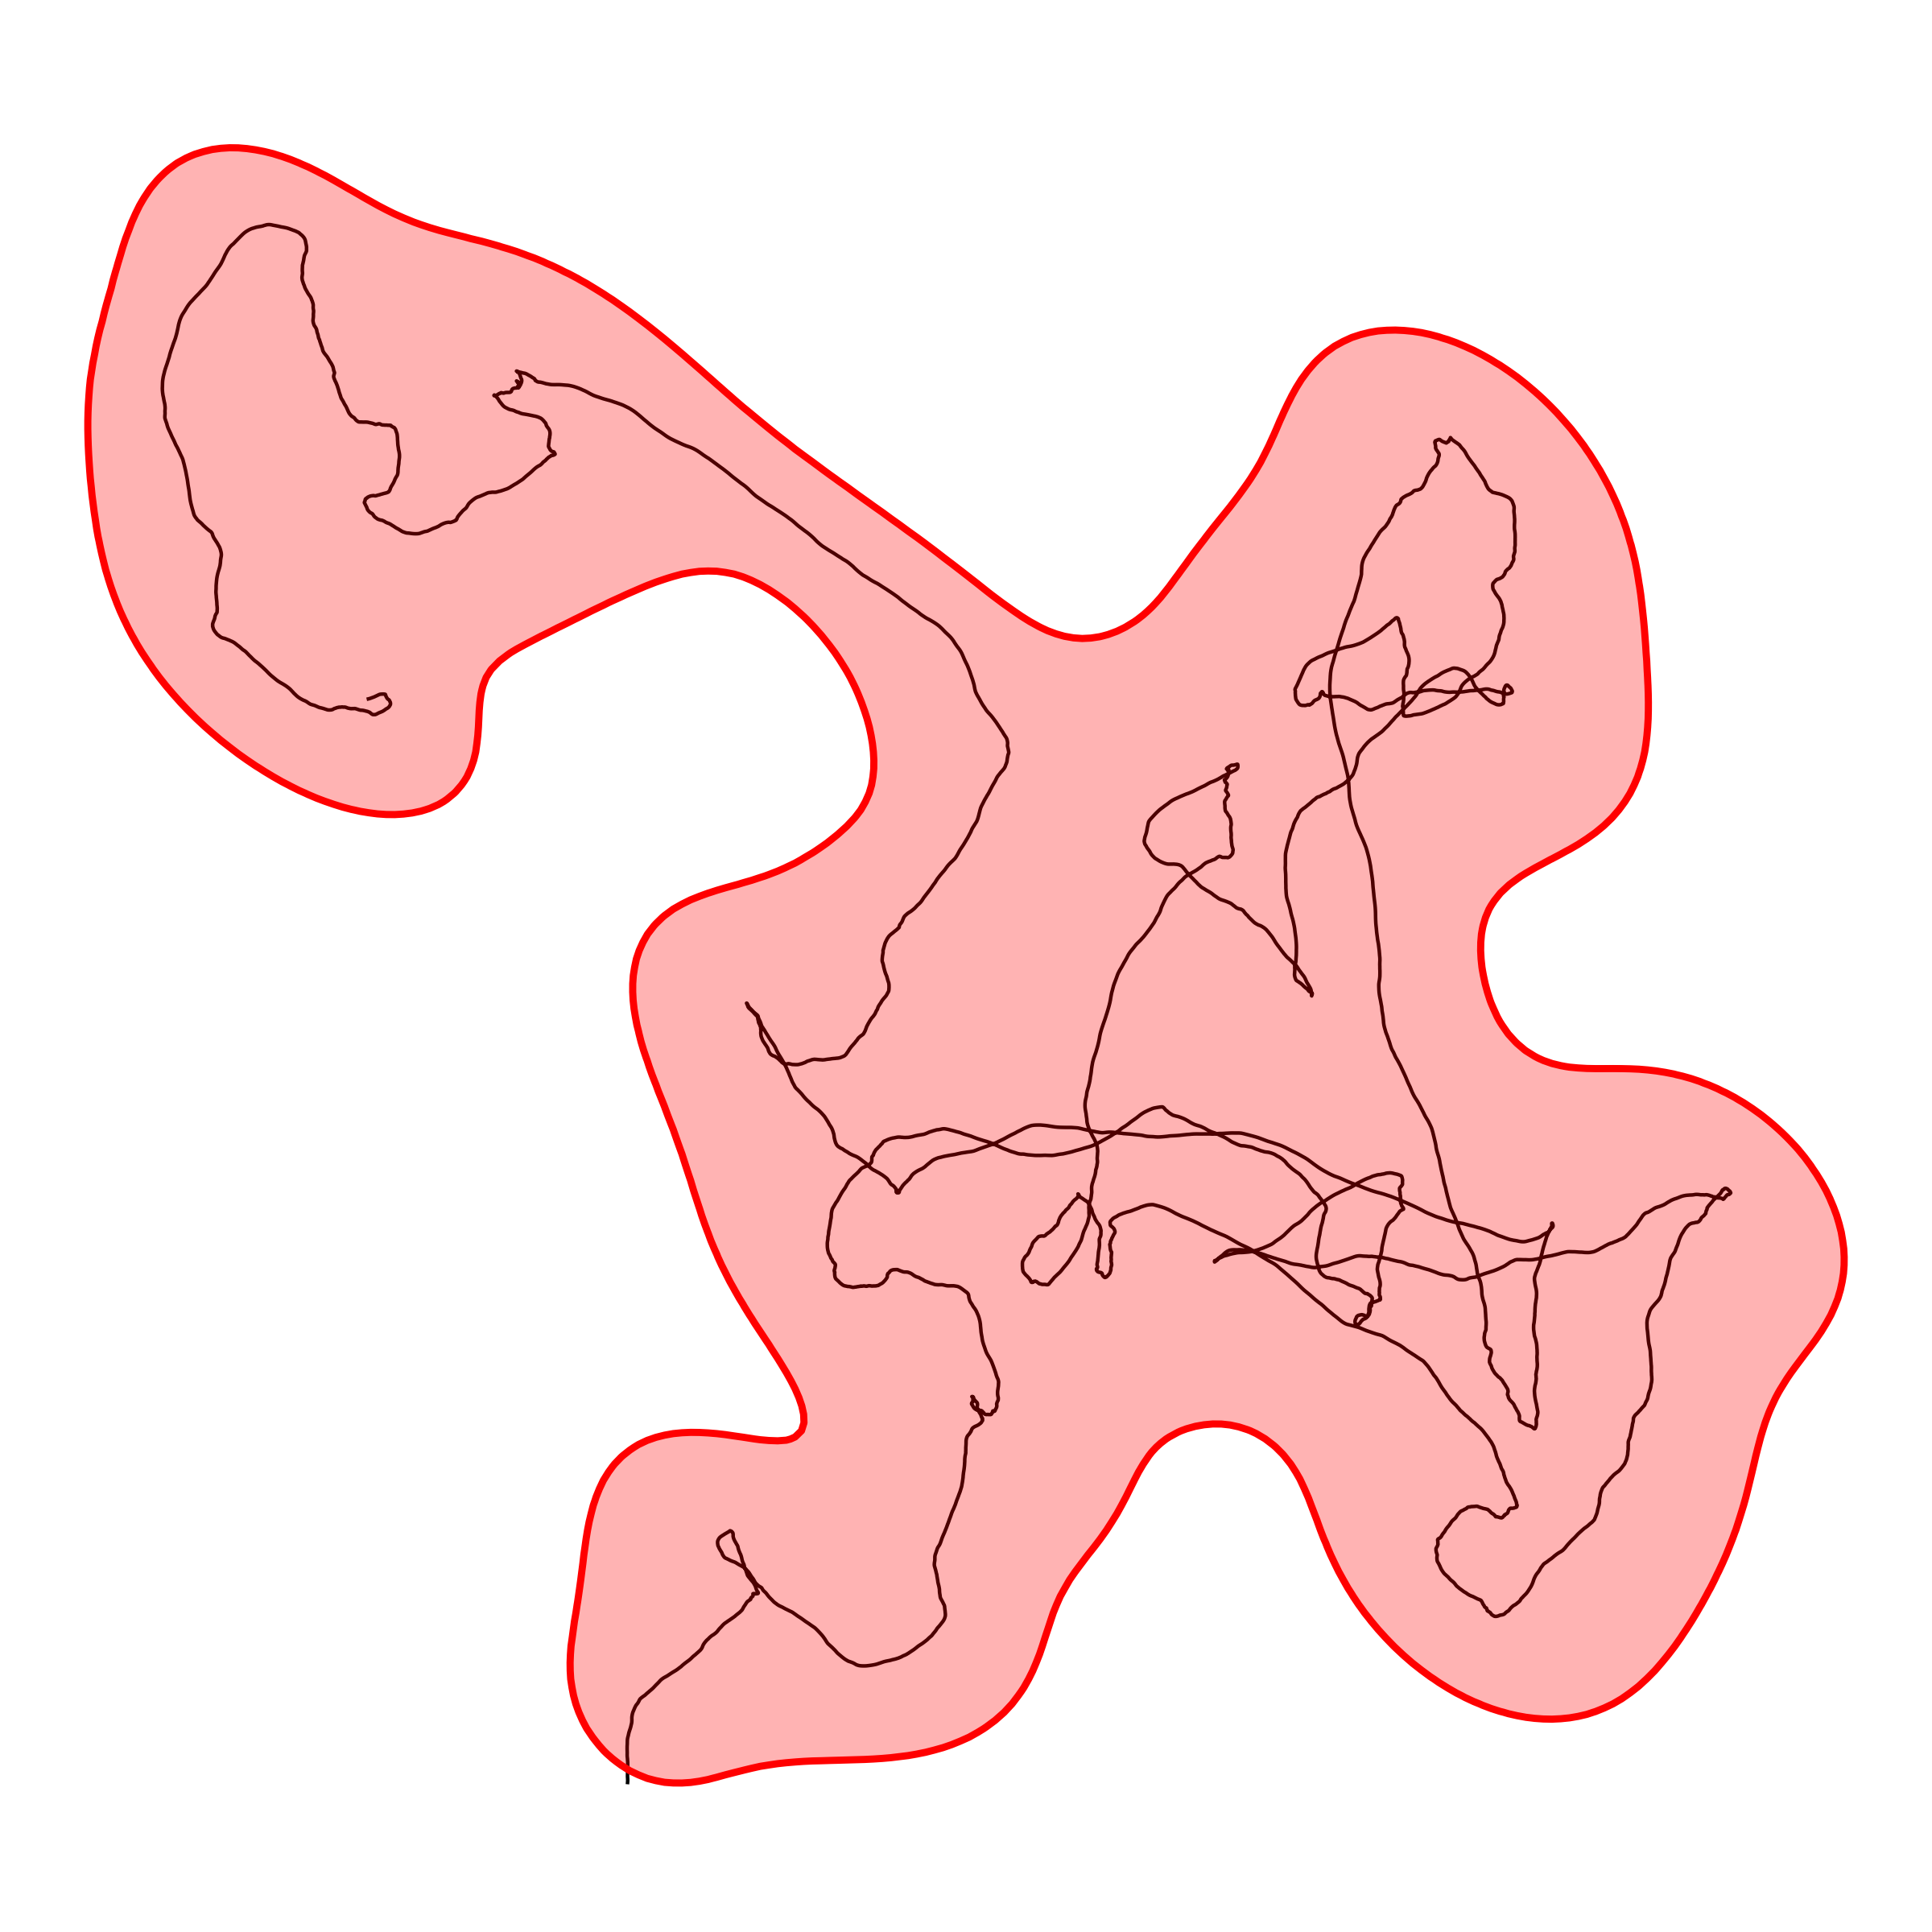
What is a home range?
Area required for essential needs
Animals must be range-resident
HR must have a stable centroid
Not applicable to:
Nomadic animals
Migrating animals
May change over time
Does not include exploratory movement

Slide 4
HR modeling requires a stable centroid
An eagle returning to its nest
A bear returning to its den
A bee returning to its hive
The center of a coyote’s hunting grounds
The center of a deer’s foraging grounds

Slide 5
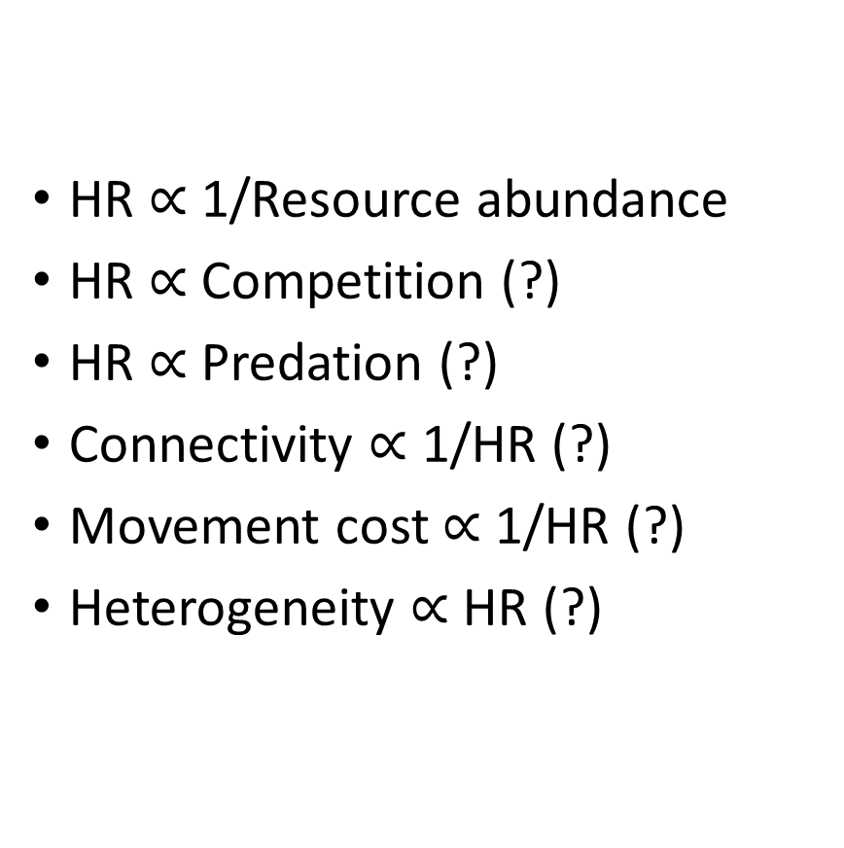
What might affect HR size?
HR $∝$ 1/Resource abundance
HR $∝$ Competition (?)
HR $∝$ Predation (?)
Connectivity $∝$ 1/HR (?)
Movement cost $∝$ 1/HR (?)
Heterogeneity $∝$ HR (?)

Slide 6
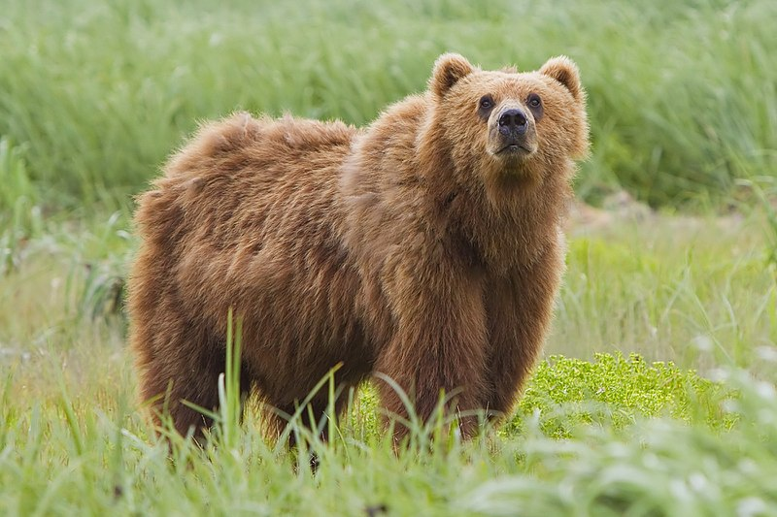
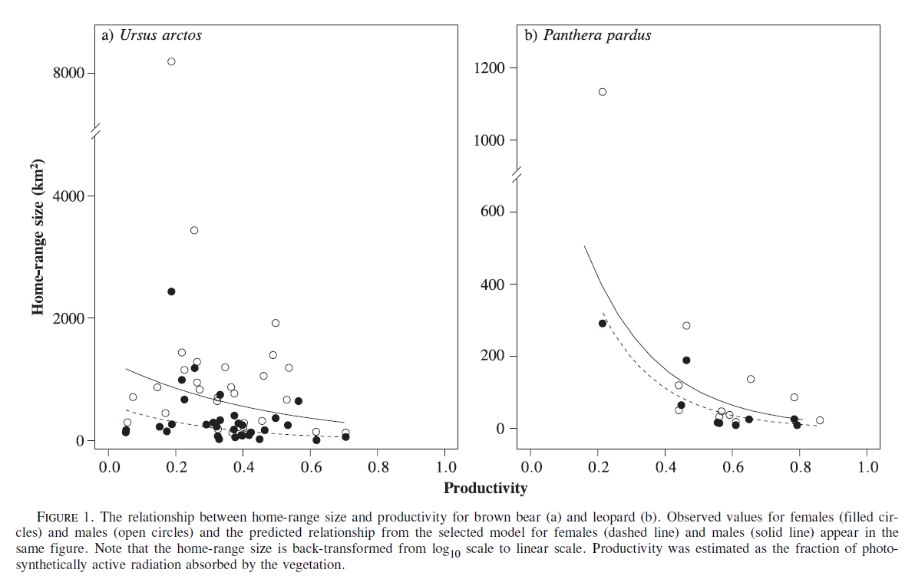
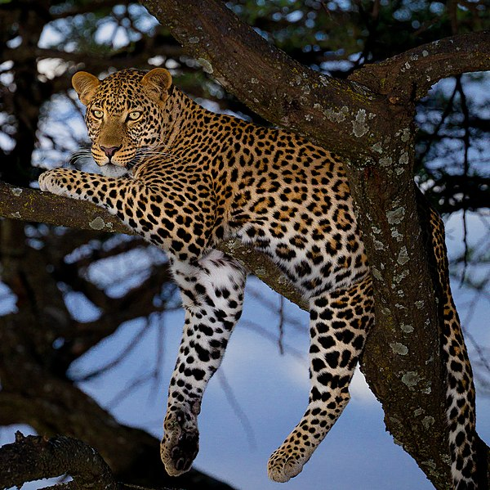
Resource abundance and HR: examples in literature
Brown bear,
Photo by Yathin S Krishnappa
(Nilsen et al. 2005)
Leopard,
Photo by Sumeet Moghe

Slide 7
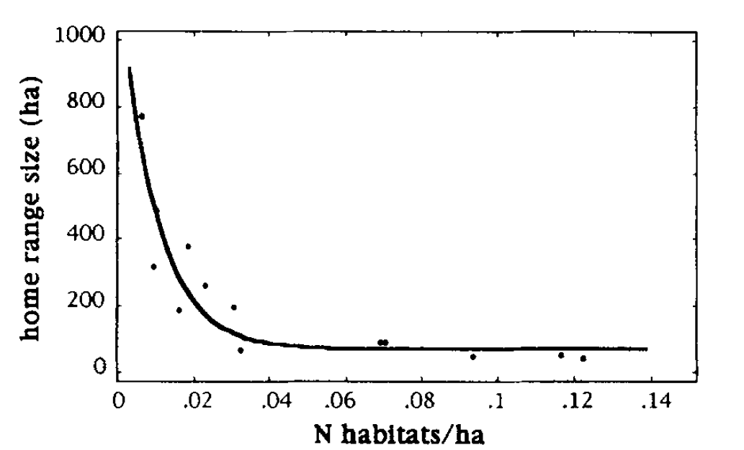
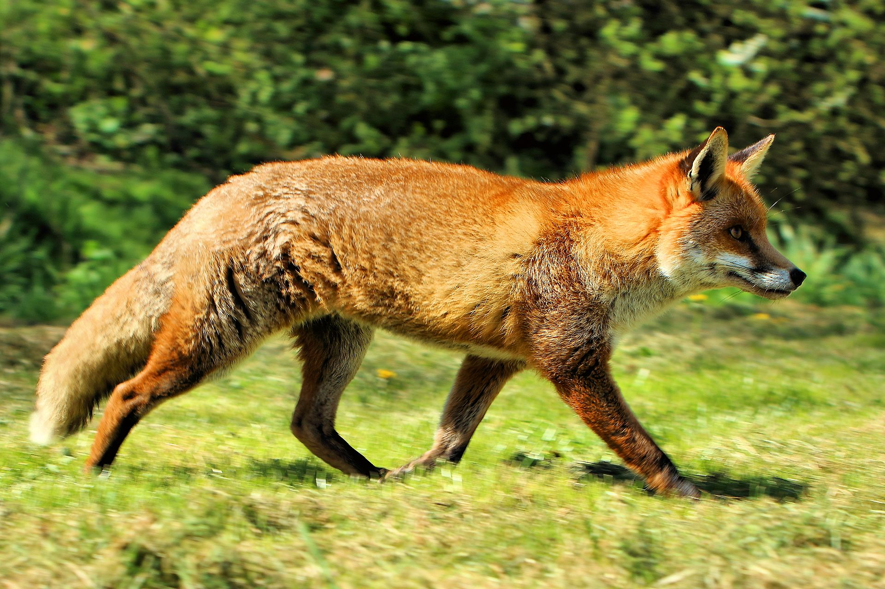
Resource abundance and HR: examples in literature
Red fox, photo by Airwolfhound
(Lucherini & Lovari 1996)

Slide 8
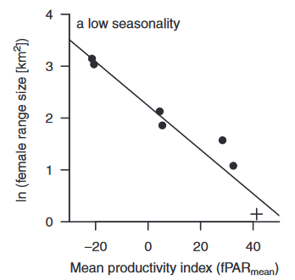
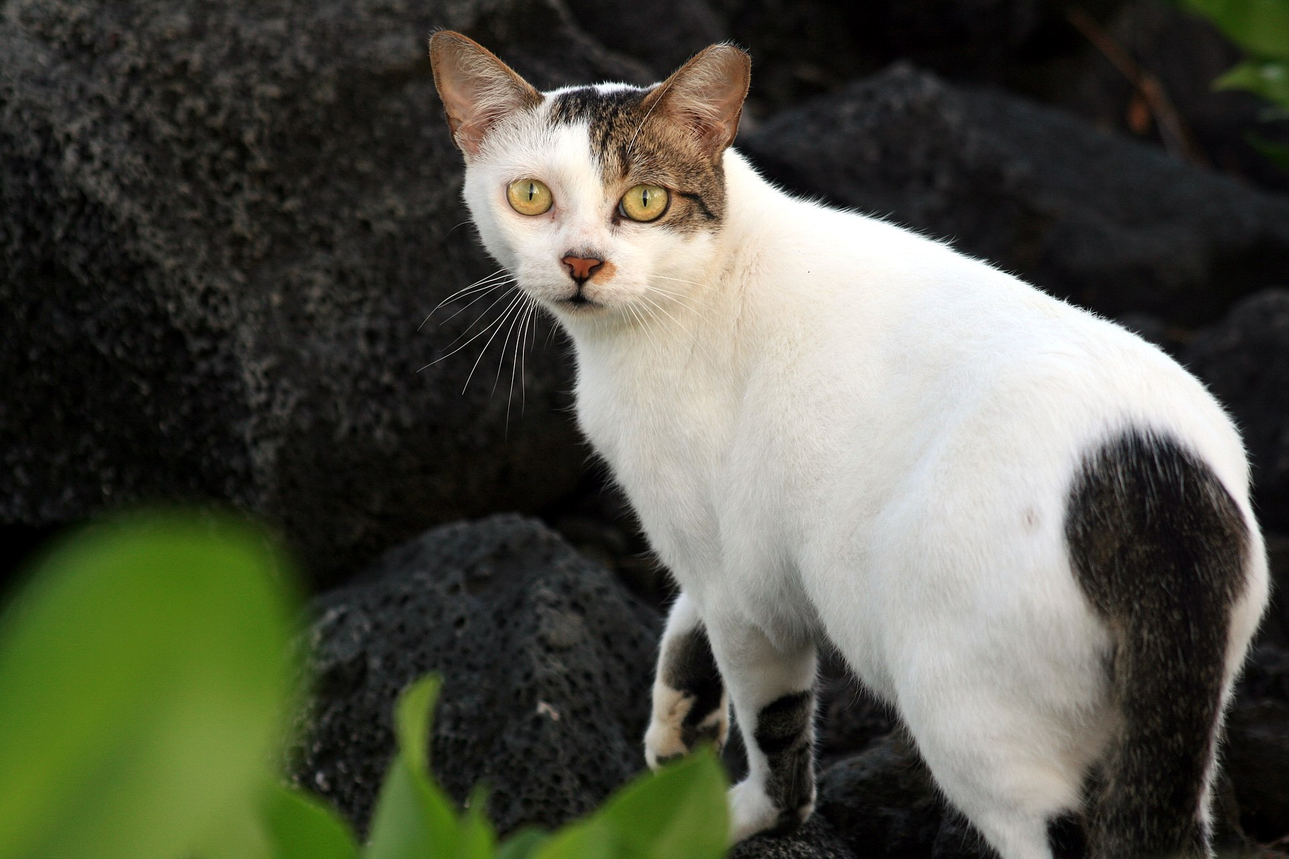
Resource abundance and HR: examples in literature
Outdoor or feral cat, photo by Brocken Inaglory
(Bengsen et al. 2015)

Slide 9
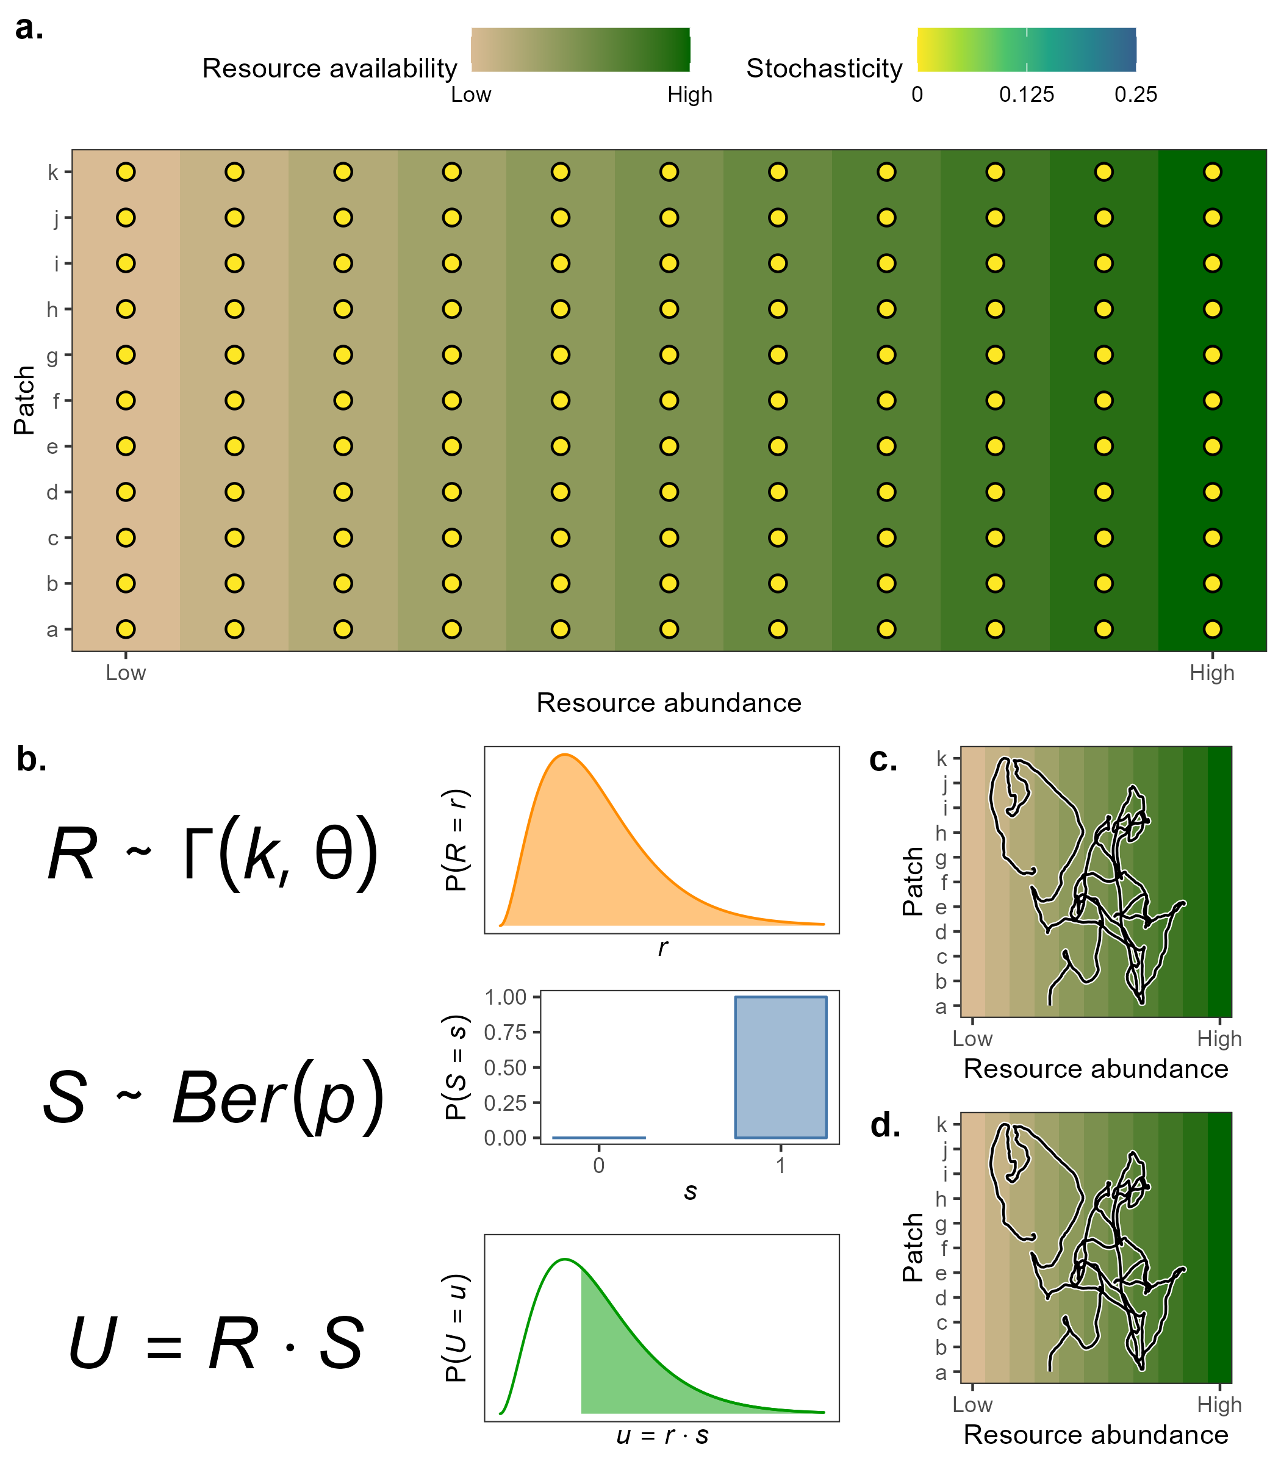
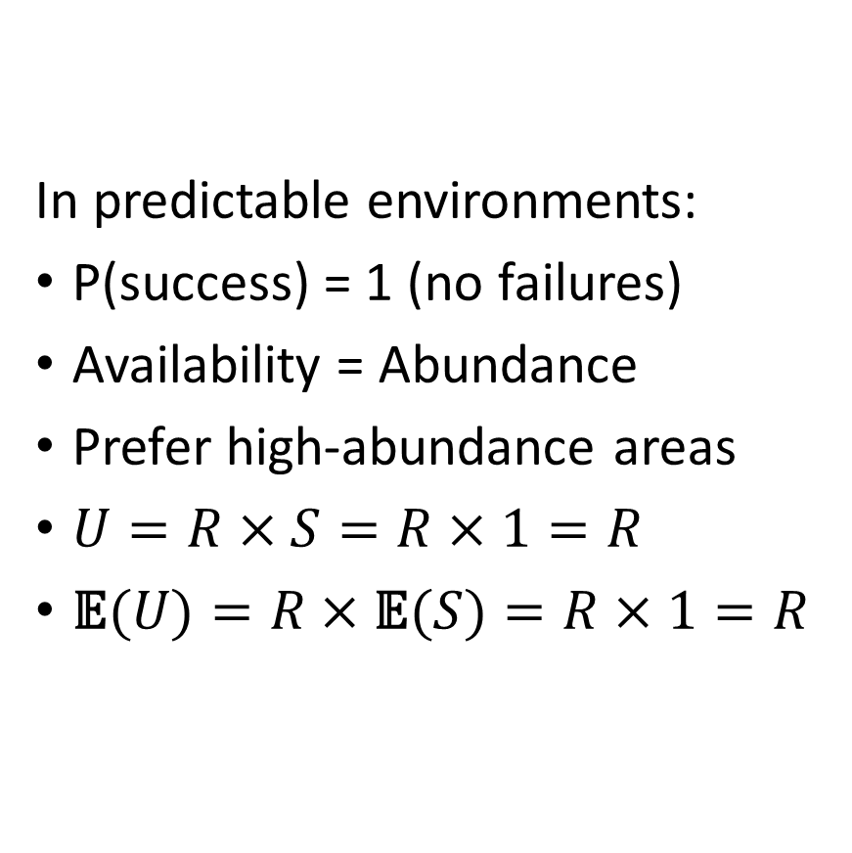
Stable environments --> stable needs
In predictable environments:
P(success) = 1 (no failures)
Availability = Abundance
Prefer high-abundance areas
$U=R×S=R×1=R$
$\text{𝔼}(U)=R×\text{𝔼}(S)=R×1=R$

Slide 10
Environmental variance is also important
Heterogeneity:
Different habitats (forest, grassland, lake…)
Seasonal changes (temperature, precipitation, light)
Stochasticity:
Extreme and rare events (fire, flood)
Climate change

Slide 11
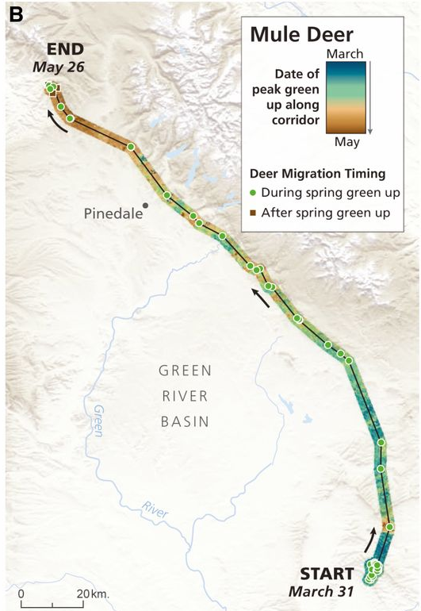
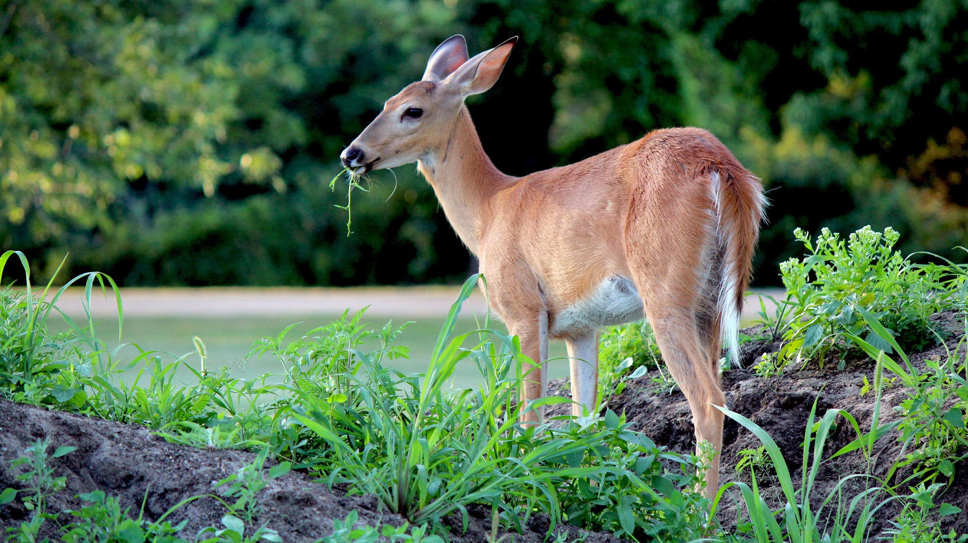
Variance and HR: examples in literature
(Geremia et al. 2019)
Foraging deer,
https://www.havahart.com/media/Articles/Havahart/Protecting-Plants-from-Deer.jpg

Slide 12
Variance and HR: examples in literature
Red fox, photo by Airwolfhound
(Lucherini & Lovari 1996)

Slide 13
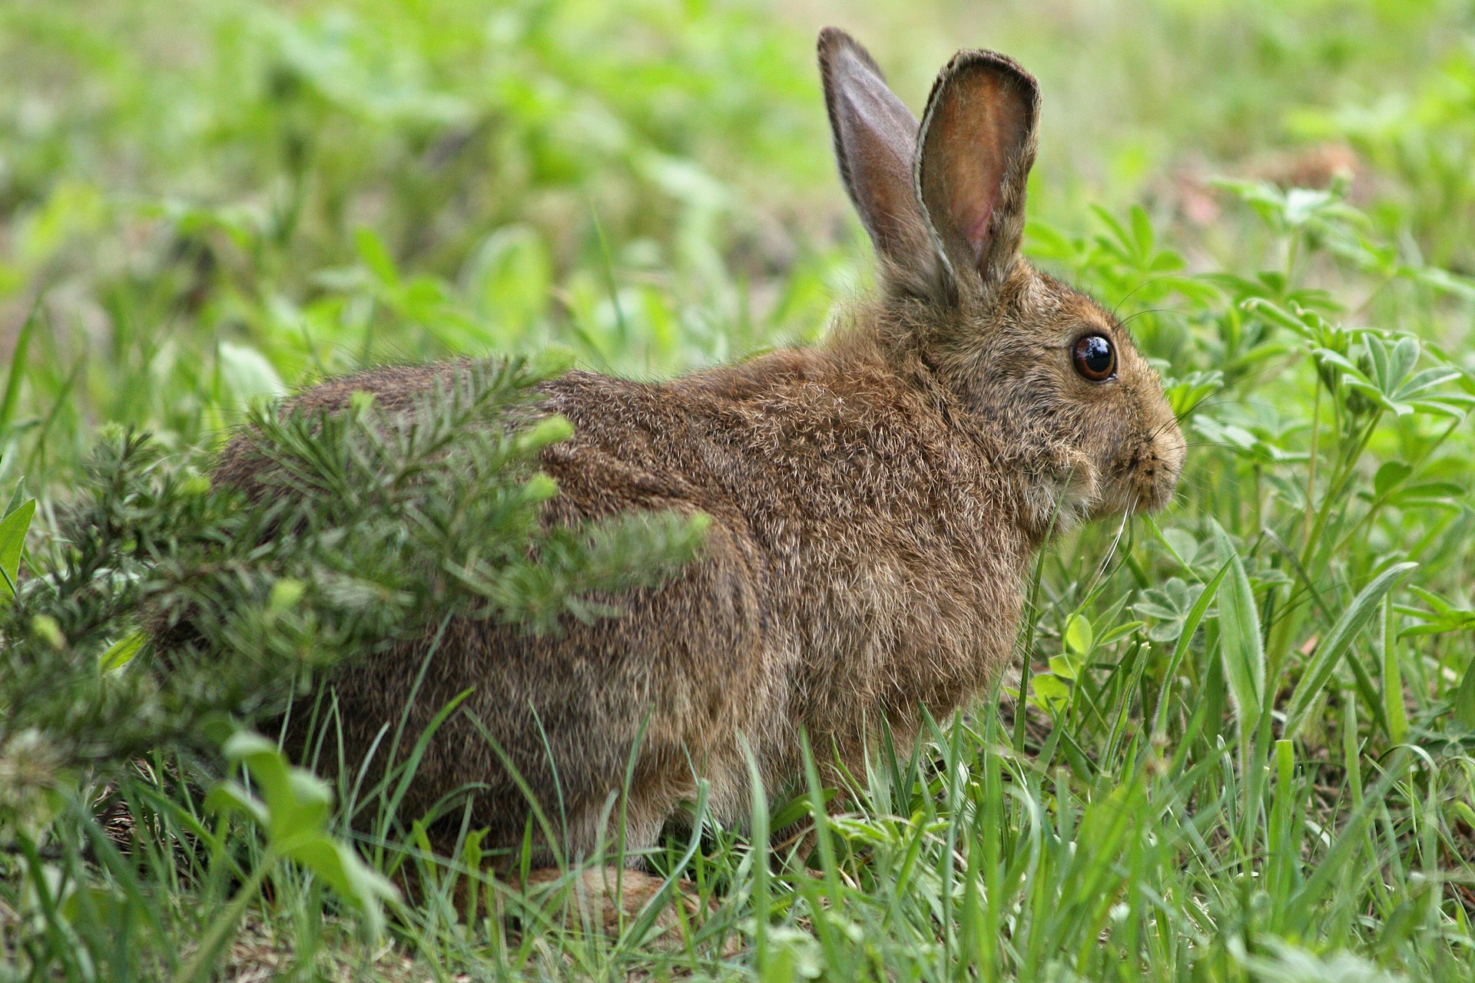
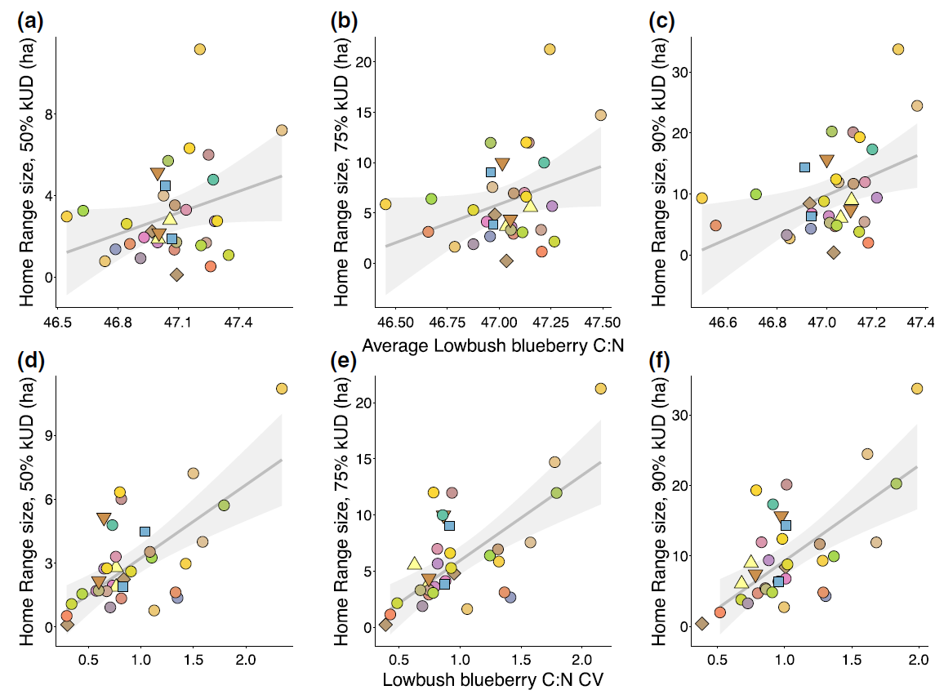
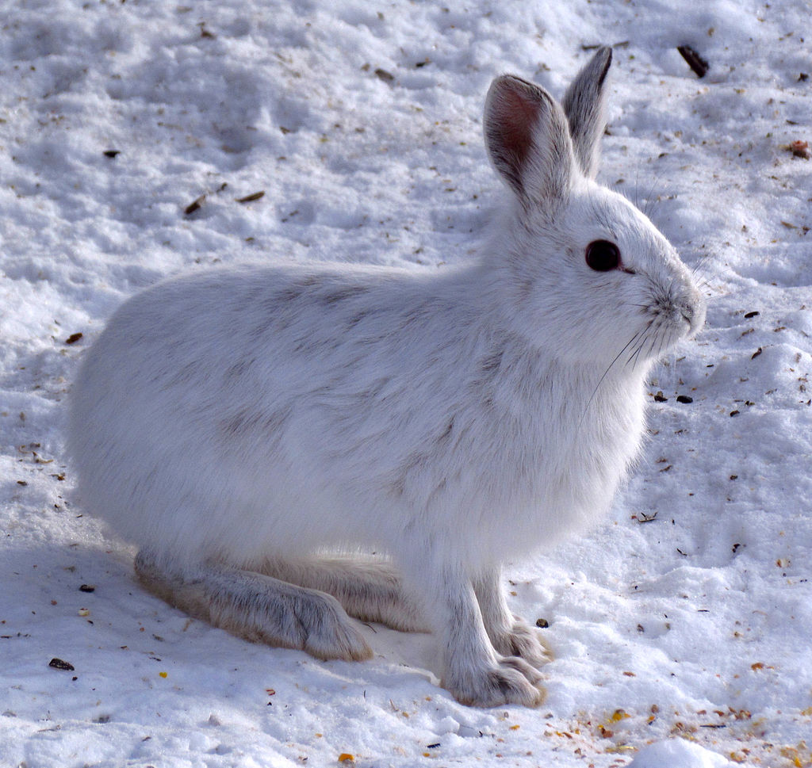
Variance and HR: examples in literature
Showshoe hares,
photos by Wsiegmund (modified) and D. Gordon E. Robertson
(Rizzuto et al. 2021)

Slide 14
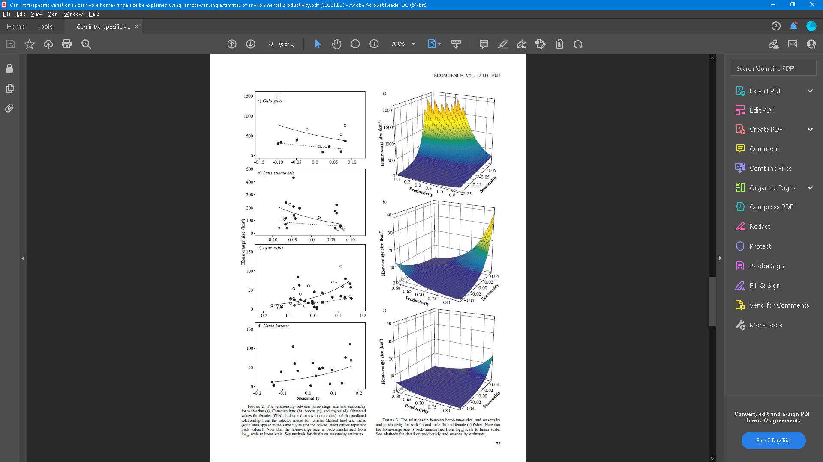
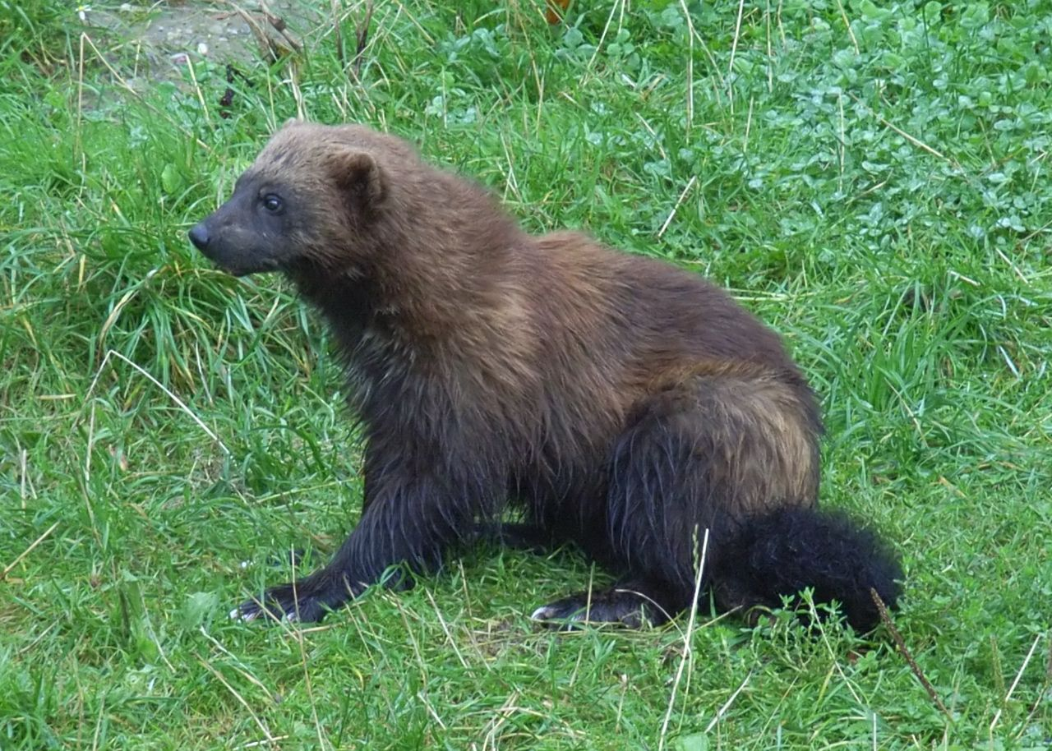
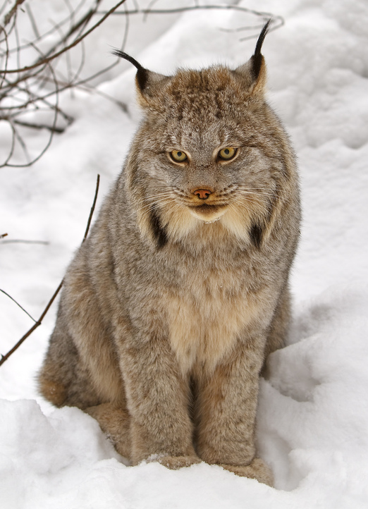
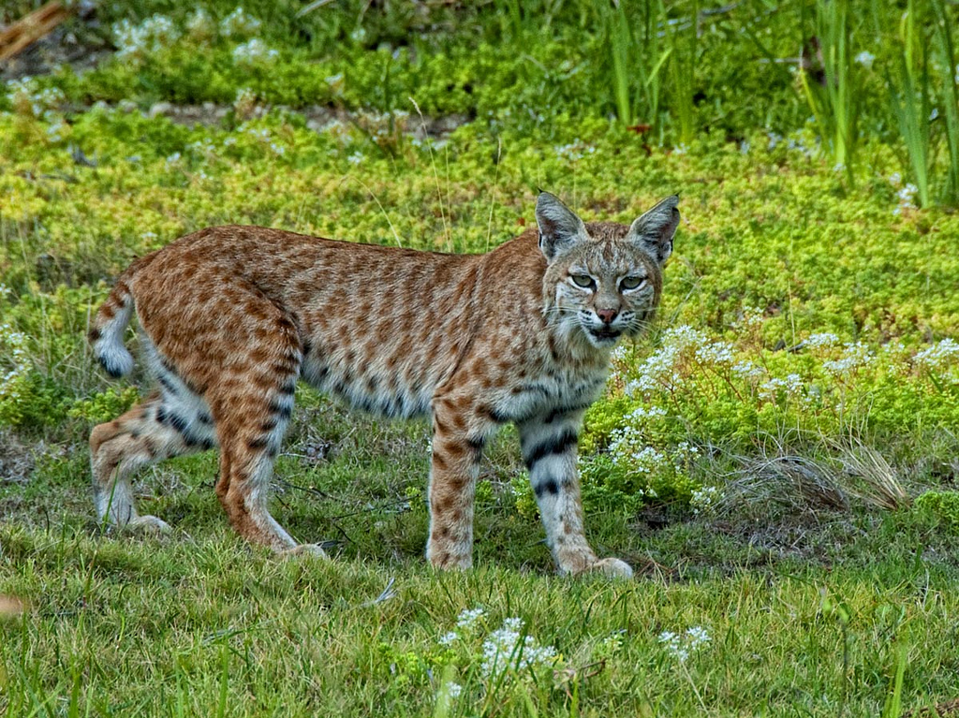
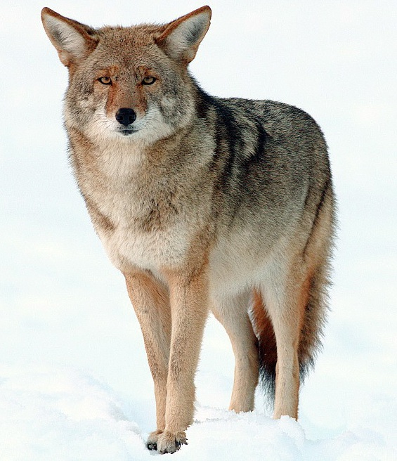
Variance and HR: examples in literature
Canadian lynx,
photo by Michael Zahra
Wolverine, photo by Zefram
Coyote,
photo by Yathin S. Krishnappa
Bobcat, photo by Bill W. Ca
(Nilsen et al. 2005)

Slide 15
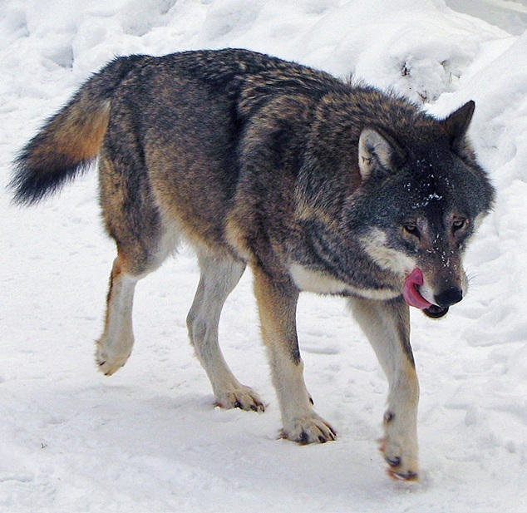
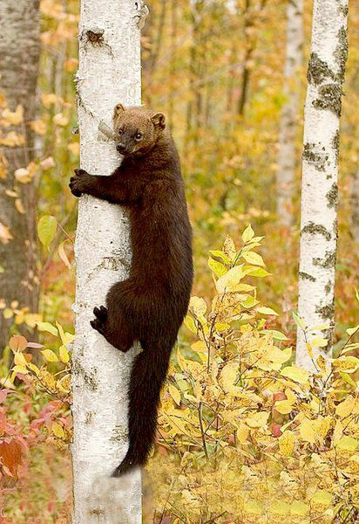
Variance and HR: examples in literature
Wolf, photo by Daniel Mott
Fisher,
photo by Douglas H. Domedion
(Nilsen et al. 2005)

Slide 16
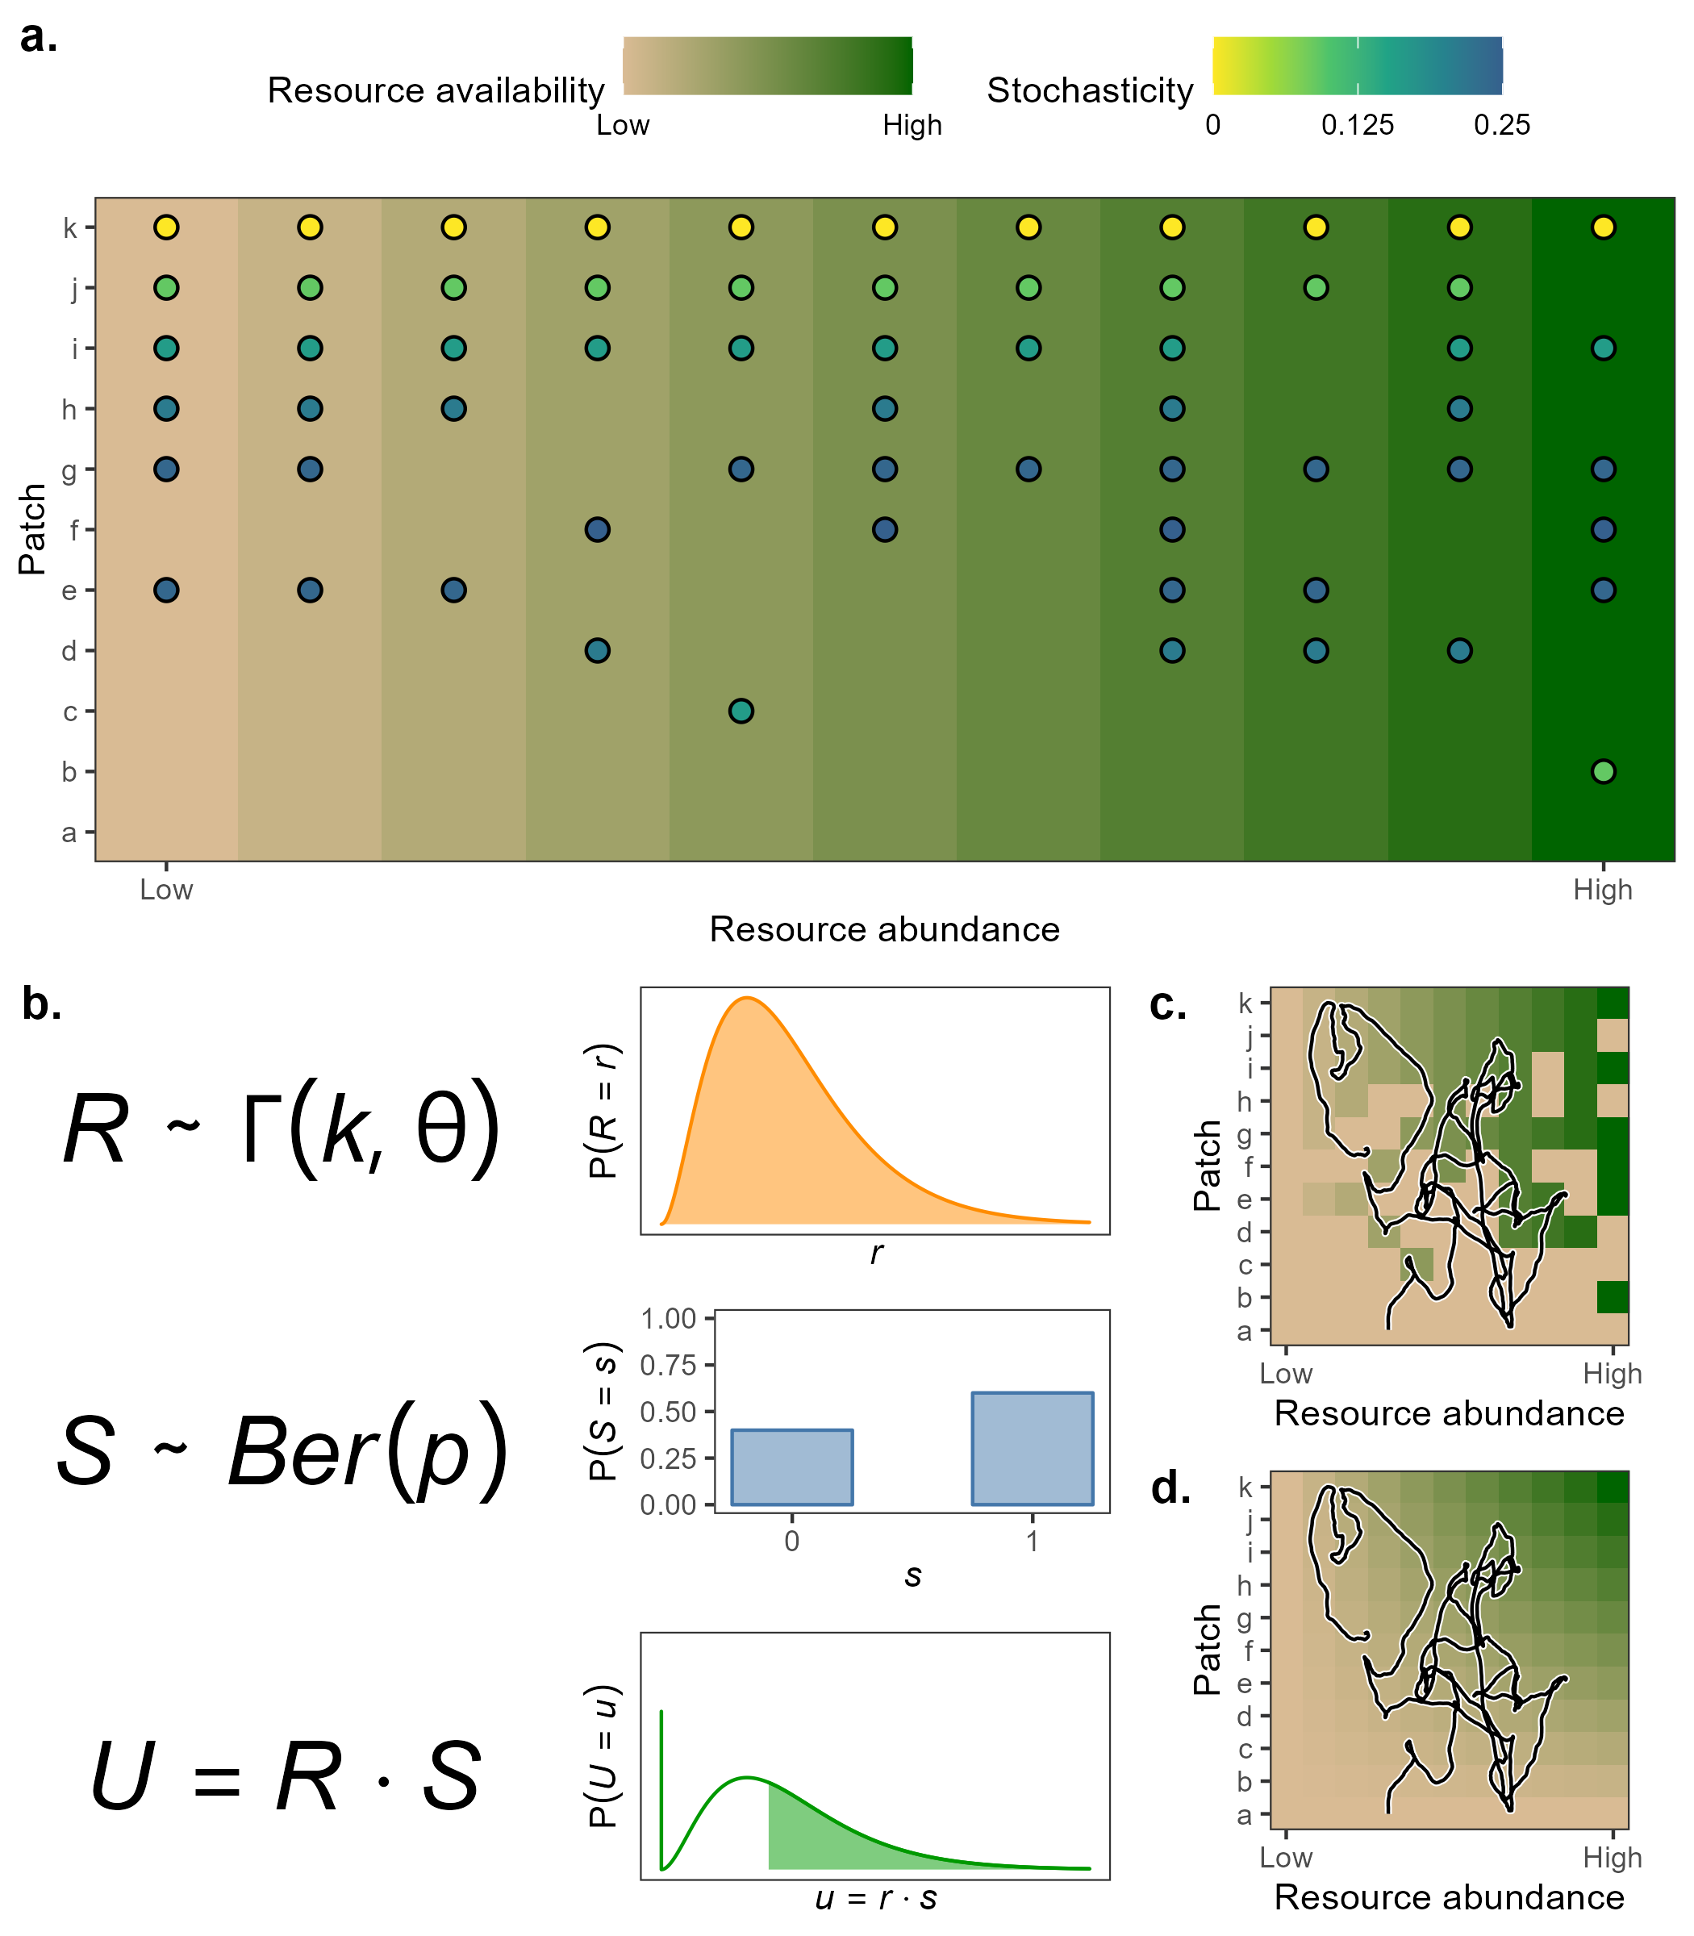
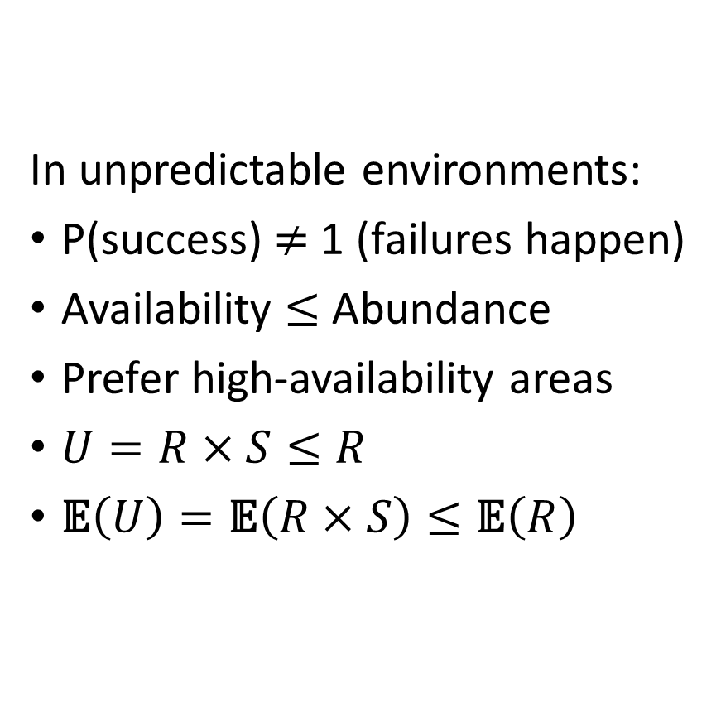
Variable environments --> variable needs
In unpredictable environments:
P(success) $≠$ 1 (failures happen)
Availability $≤$Abundance
Prefer high-availability areas
$U=R×S≤R$
$\text{𝔼}\left(U\right)=\text{𝔼}\left(R×S\right)≤\text{𝔼}\left(R\right)$

Slide 17
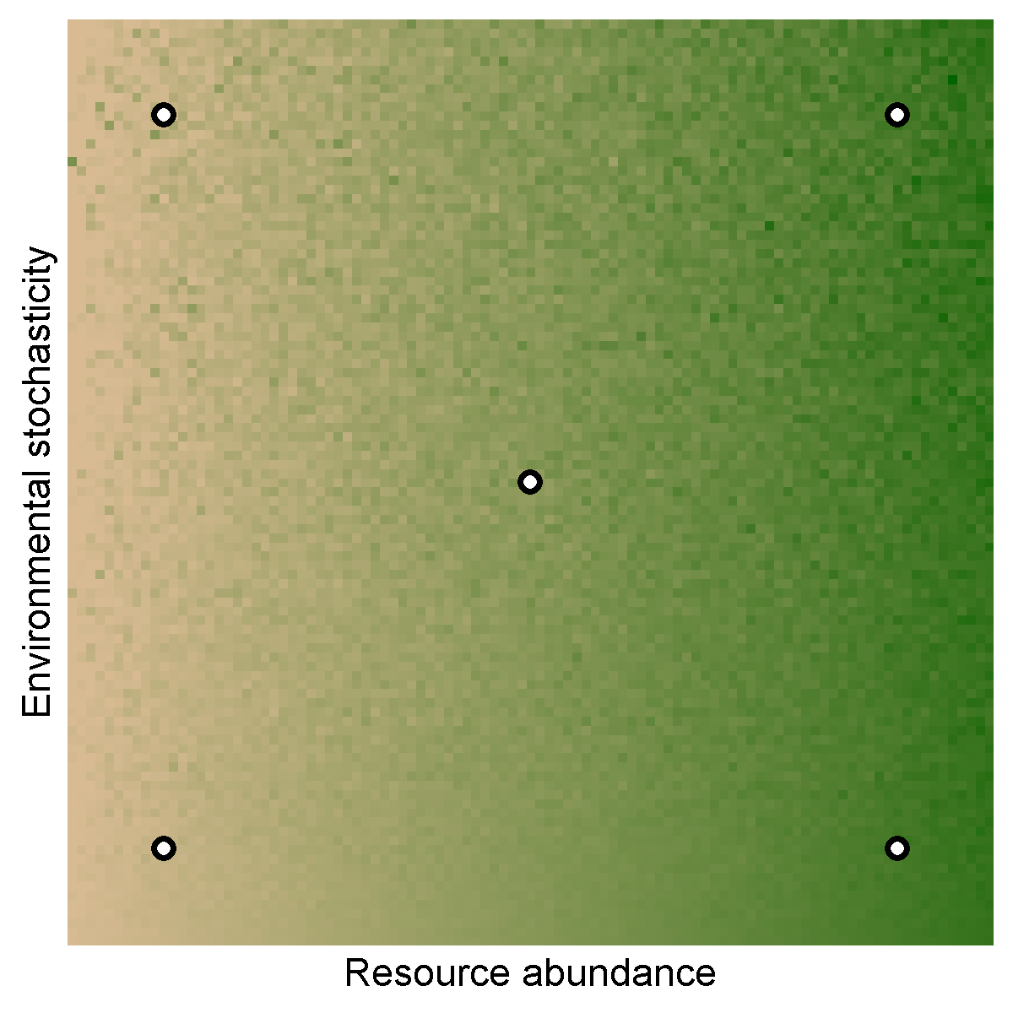
Abundance, variance and HR: simulating movement

Slide 18
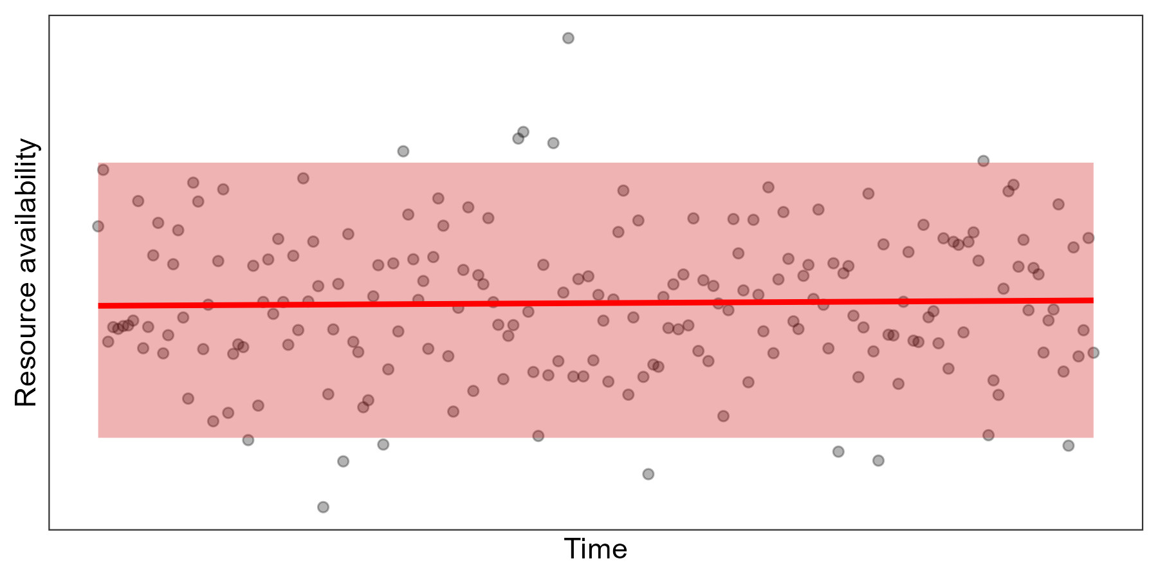
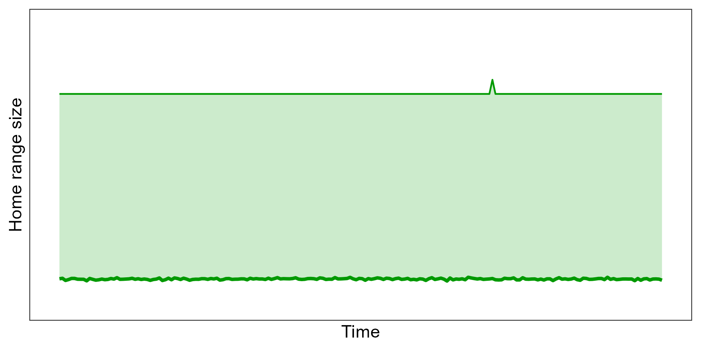
Stationary environments --> constant HR
Constant mean
Constant variance
HR remains constant over time

Slide 19
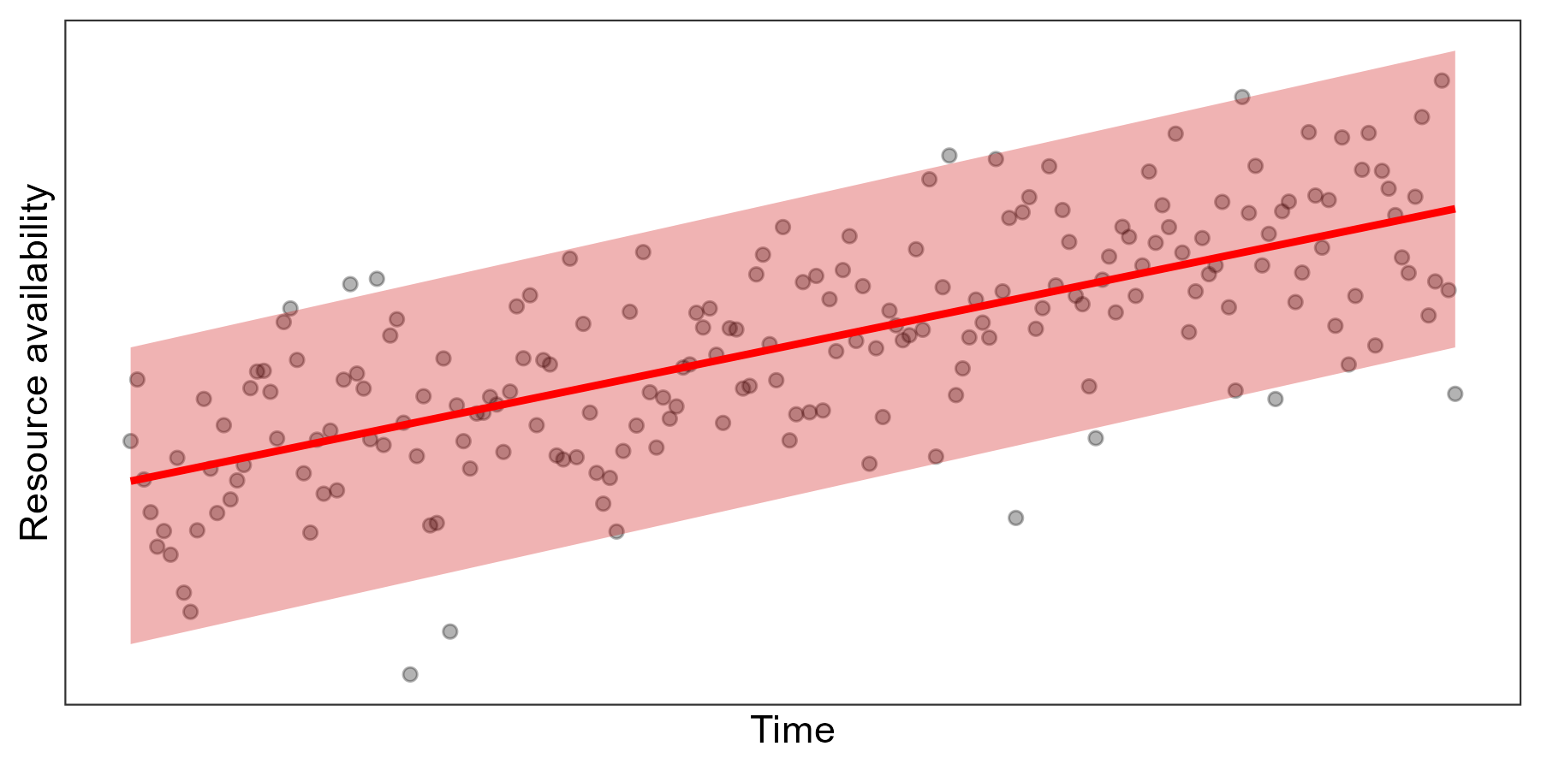
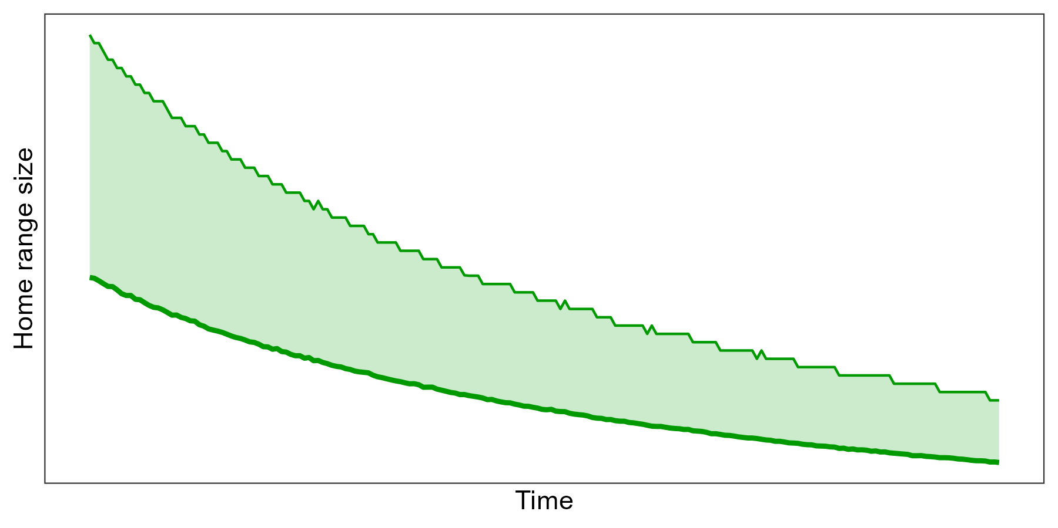
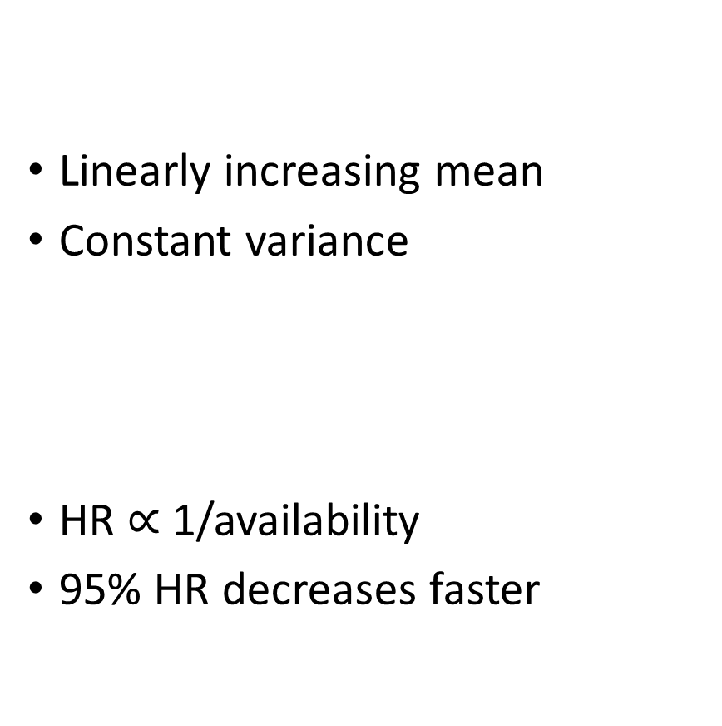
Changing mean --> HR changes rapidly
Linearly increasing mean
Constant variance
HR $∝$ 1/availability
95% HR decreases faster

Slide 20
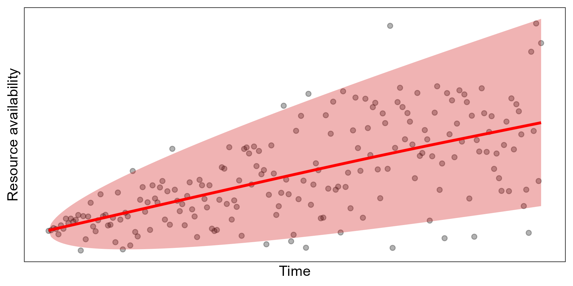
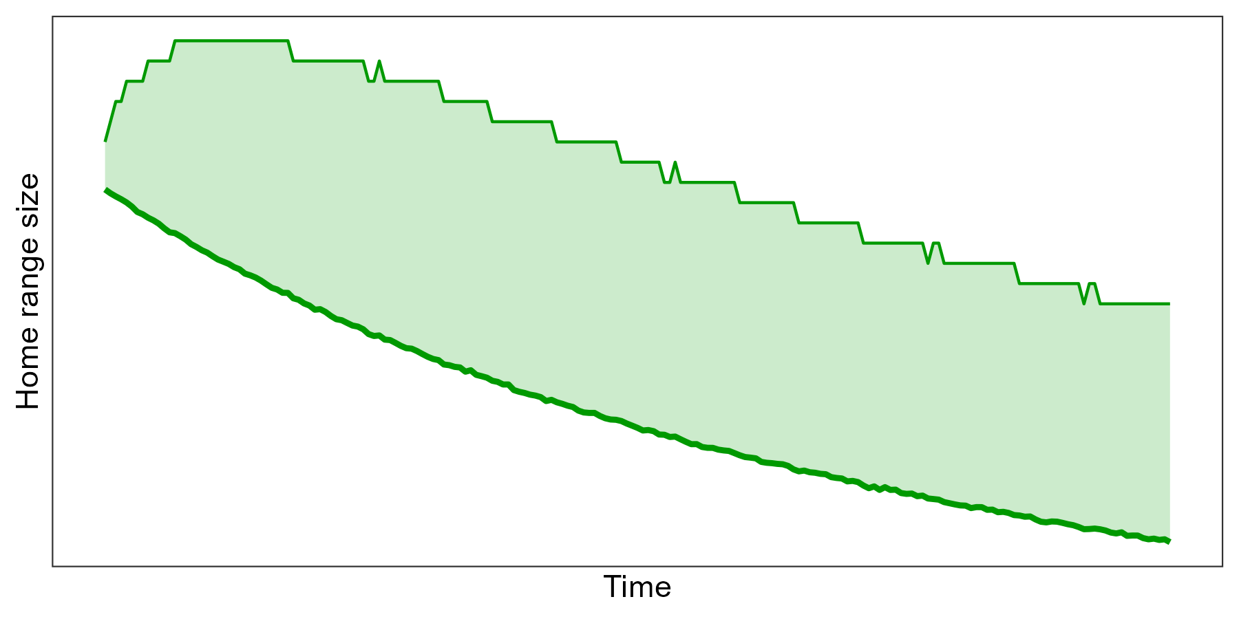
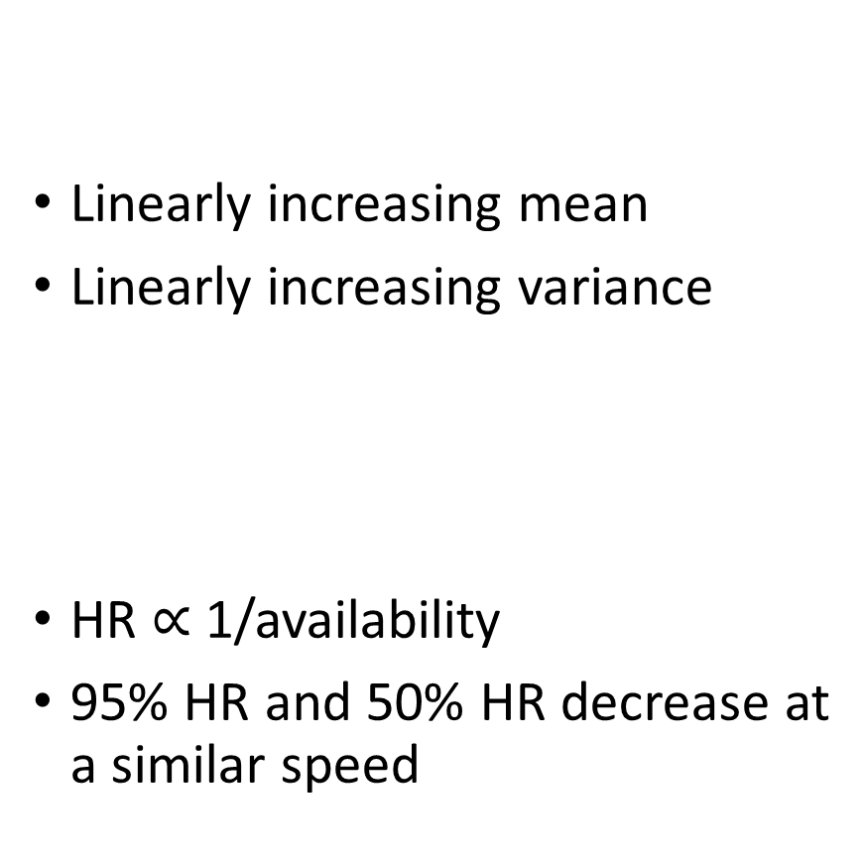
Changing mean and variance --> HR can change slowly
Linearly increasing mean
Linearly increasing variance
HR $∝$ 1/availability
95% HR and 50% HR decrease at a similar speed

Slide 21
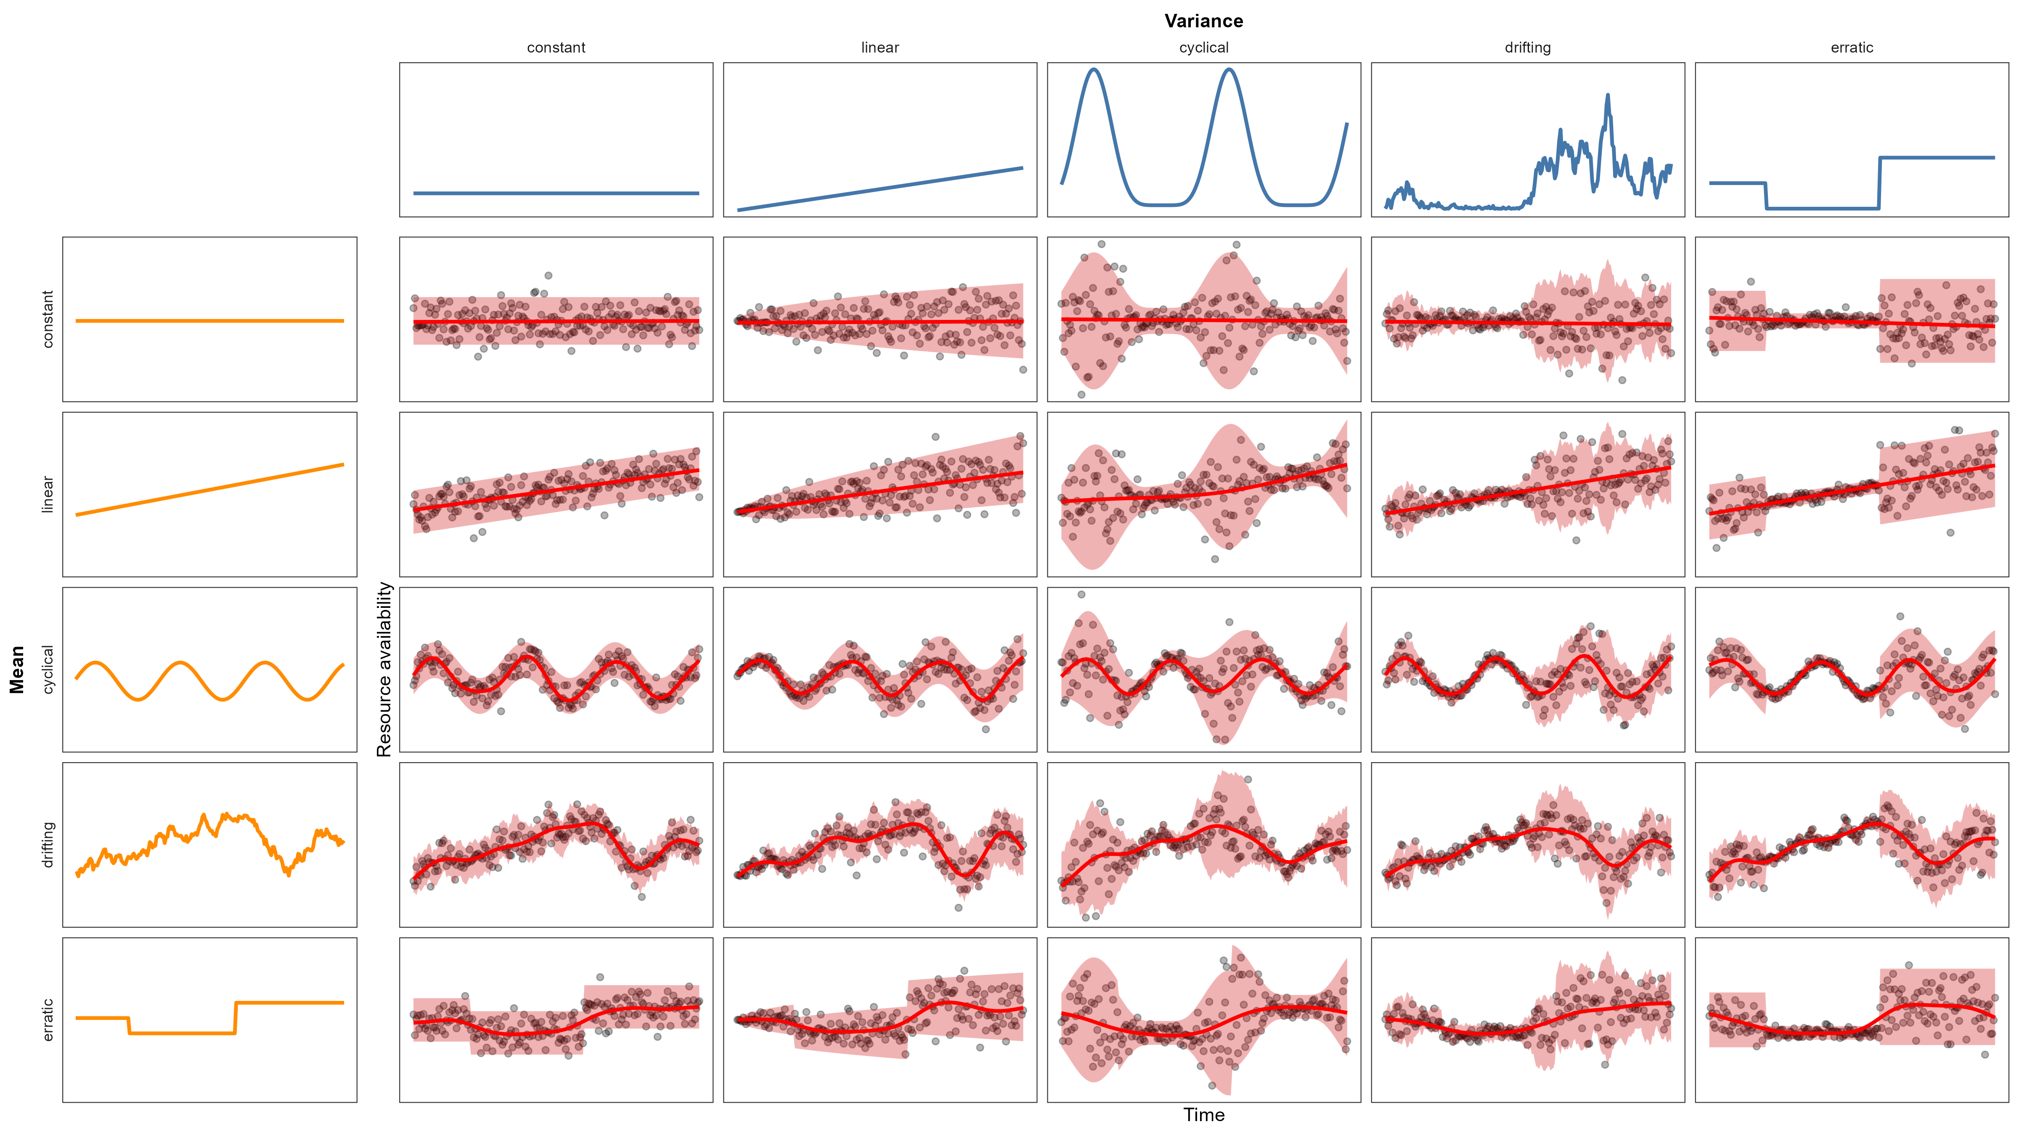
Relationships can be complicated…

Slide 22
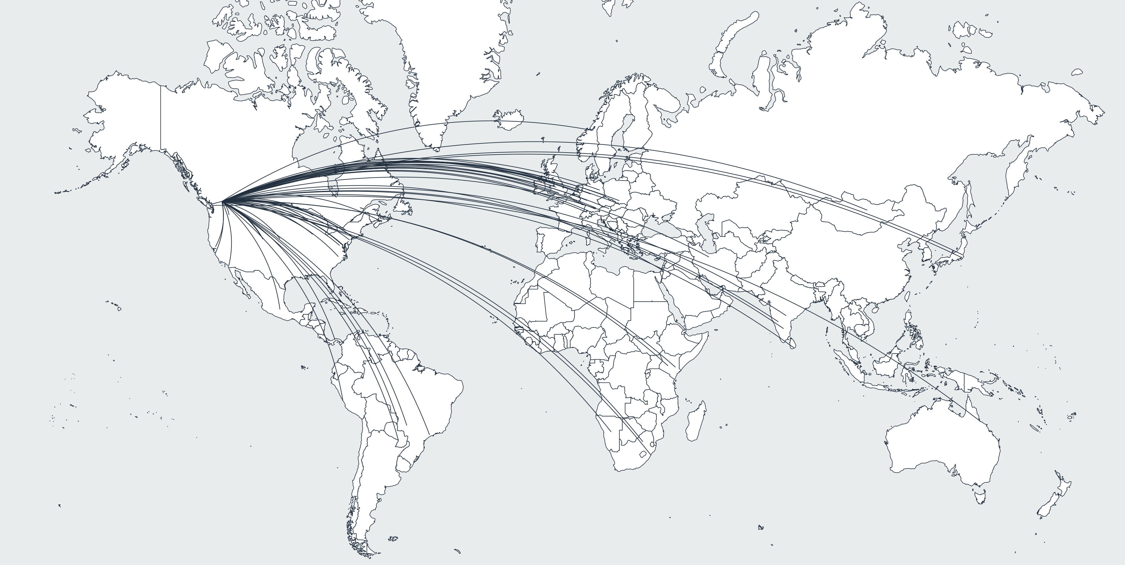
Modeling it all
Movebank dataset:
> 1500 animals
> 75 species
New global raster of environmental variance
Continuous time movement models (ctmm R package)
Hierarchical modeling for common trends (mgcv R package)

Slide 23
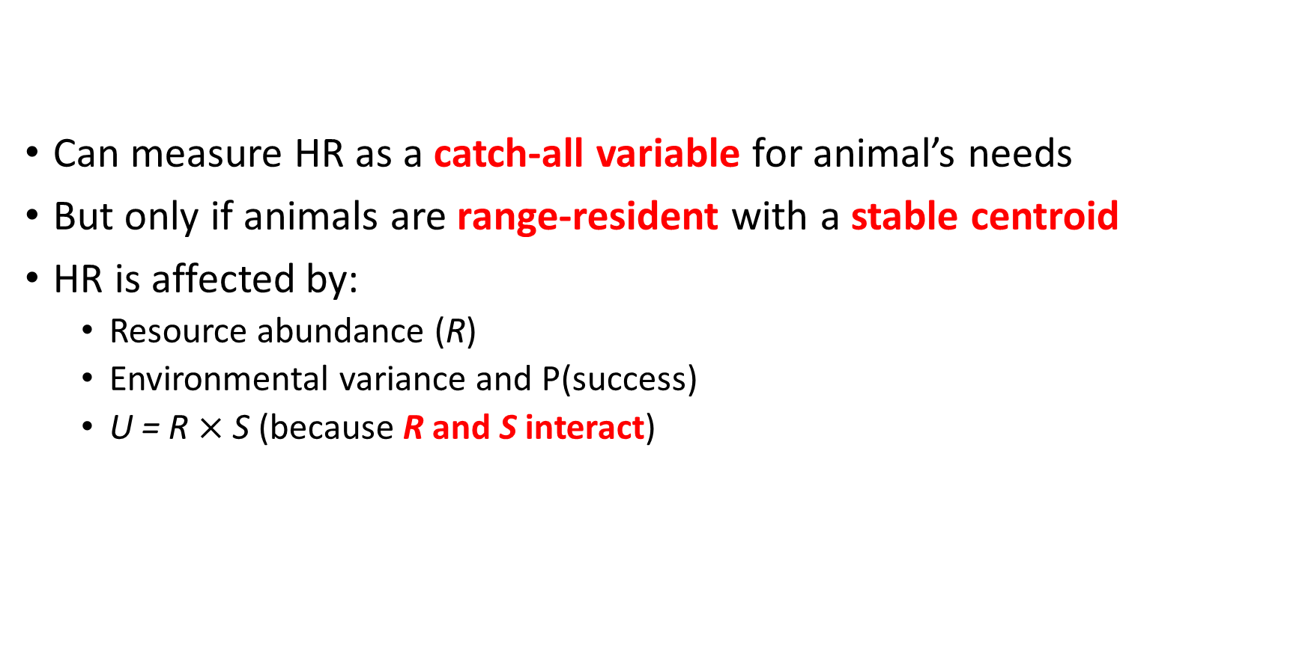
Summary
Can measure HR as a catch-all variable for animal’s needs
But only if animals are range-resident with a stable centroid
HR is affected by:
Resource abundance (R)
Environmental variance and P(success)
U = R $×$ S (because R and S interact)

Slide 24



Funder acknowledgements

Slide 25

Summary
Can measure HR as a catch-all variable for animal’s needs
But only if animals are range-resident with a stable centroid
HR is affected by:
Resource abundance (R)
Environmental variance and P(success)
U = R $×$ S (because R and S interact)
Stefano Mezzini – M.Sc. Biol.
stefano.mezzini@ubc.ca

Slide 26
References
Bengsen A.J., Algar D., Ballard G., Buckmaster T., Comer S., Fleming P.J.S., et al. (2016). Feral cat home-range size varies predictably with landscape productivity and population density. Journal of Zoology 298, 112–120. https://doi.org/10.1111/jzo.12290
Geremia C., Merkle J.A., Eacker D.R., Wallen R.L., White P.J., Hebblewhite M., et al. (2019). Migrating bison engineer the green wave. Proceedings of the National Academy of Sciences 116, 25707–25713. https://doi.org/10.1073/pnas.1913783116
Lucherini M. & Lovari S. (1996). Habitat richness affects home range size in the red fox Vulpes vulpes. Behavioural Processes 36, 103–105. https://doi.org/10.1016/0376-6357(95)00018-6
Nilsen E.B., Herfindal I. & Linnell J.D.C. (2005). Can intra-specific variation in carnivore home-range size be explained using remote-sensing estimates of environmental productivity? Écoscience 12, 68–75. https://doi.org/10.2980/i1195-6860-12-1-68.1
Rizzuto M., Leroux S.J., Vander Wal E., Richmond I.C., Heckford T.R., Balluffi-Fry J., et al. (2021). Forage stoichiometry predicts the home range size of a small terrestrial herbivore. Oecologia 197, 327–338. https://doi.org/10.1007/s00442-021-04965-0

